Slide 1

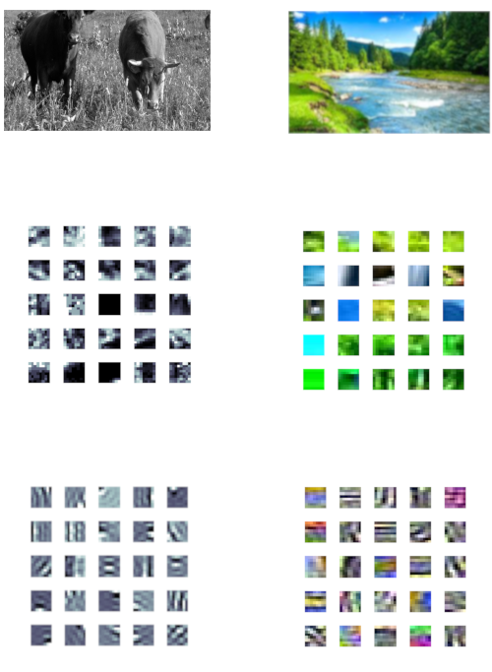
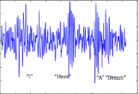

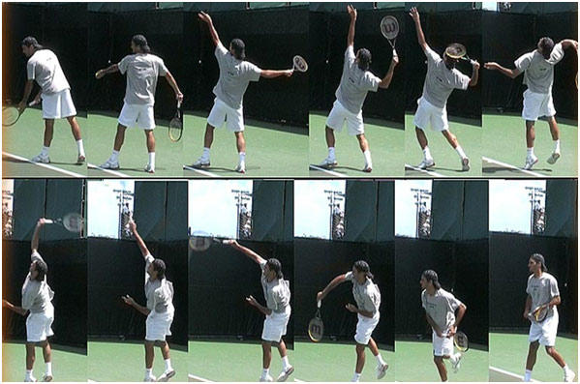
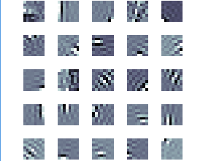
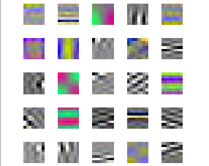
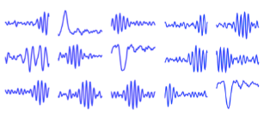
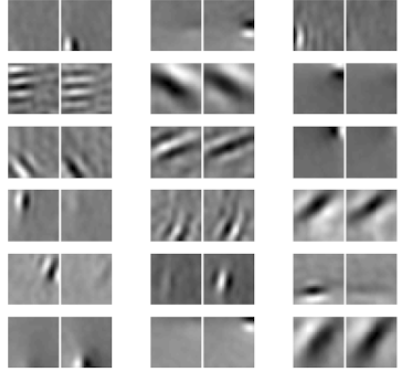
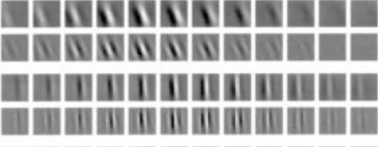
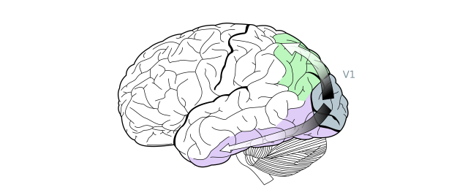
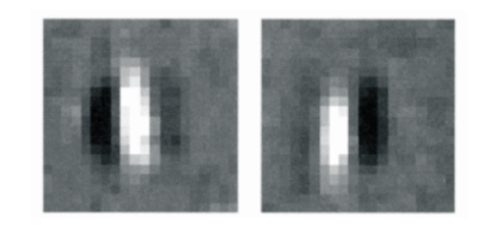
Efficient Neural Coding of Images and Video to Derive Receptive Fields
Harmeet Singh, Patrick Nolan, Zachary Barrett, Mark V. Albert
Introduction
Processing Stimuli at the
Lowest Level
Deriving a Receptive Field
What is Efficient Coding
The brain is efficient when it minimizes the amount of times neurons have to fire to transmit signals
Benefit of Efficient Encoding Efficient encoding allows the brain to minimize energy usage
What our program does
Our program aims to mimic the process the brain goes through and creates receptive fields
Receptive fields show us hot spots of what a neuron would respond to from an image
The program also demonstrates how similarly different stimuli (see figure 3) are processed by the brain
All of these different forms of sensory information undergo the same efficient encoding when processed
Figure 2: Grayscale vs Color Image Encoding
Figure 3: Different Stimuli Undergoing Same Efficient Coding Process
Grayscale
Color
Audio
Binocular
Video
Natural Image
Full Image being processed
Natural Images
Sample
8x8 pixel samples from various natural images
Algorithm images are fed through
Efficient Encoding
Receptive Fields in the Brain
Produced Neural Receptive field
Receptive fields derived from the 8x8 samples after running the images through ICA
Figure 1: Primary Visual Cortex
Resulting receptive fields
Through our experiments, we’ve come to the conclusion that luminance is a key component for image processing in the brain, more so than color.
The few colored filters show the red/green and blue/yellow dominance of the
Opponent-Process theory
Grayscale images, color images, video, audio, and binocular images all undergo the same process at their lowest level.
References
Albert, Mark V, et al. “ChiPy/ACM.” ChiPy/ACM, chipy2017.pacsites.org/.
Hunt JJ, Dayan P, Goodhill GJ (2013) Sparse Coding Can Predict Primary Visual Cortex Receptive Field Changes Induced by Abnormal Visual Input. PLoS Comput Biol 9(5): e1003005. https://doi.org/10.1371/journal.pcbi.1003005
Jones, Judson P, and Larry A Palmer. “The Two-Dimensional Spatial Structure of Simple Receptive Fields in Cat Striate Cortex.” https://pdfs.semanticscholar.org/e0f4/67aa2dace57f4b7befdb331c4fd3e0033765.pdf
“Seeing the Movement: Our Visual Brain at Work.” Neurokunst, 18 Feb. 2017, www.neurokunst.com/2017/02/18/seeing-the-movement-our-visual-brain-at-work/.
http://www.neurokunst.com/2017/02/18/seeing-the-movement-our-visual-brain-at-work/
Van Hateren, J H, and D L Ruderman. “Independent Component Analysis of Natural Image Sequences Yields Spatio-Temporal Filters Similar to Simple Cells in Primary Visual Cortex.” Proceedings of the Royal Society B: Biological Sciences 265.1412 (1998): 2315–2320. Print.
http://i4tour.info/video-picture-frames
https://www.videoblocks.com/video/ocean-coastline---view-through-binoculars-hjzgfovgio6zp7yu
This figure illustrates the region in the brain where the Primary Visual Cortex is located. This is where visual processing occurs. Below this figure is a a real visual receptive field which is generated in this area of the brain.

